Slide 1
Machine Learning

Slide 2
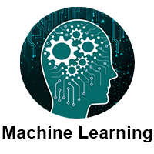
What is Machine Learning
Machine learning is a growing technology that enables computers to learn automatically from past data. Machine learning uses various algorithms for building mathematical models and making predictions using historical data or information. Currently, it is being used for various tasks such as image recognition, speech recognition, email filtering, Facebook auto-tagging, a recommender system, and many more.

Slide 3
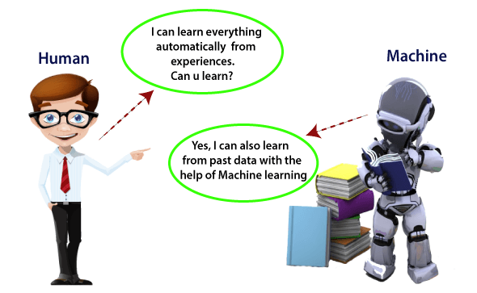
Machine Learning is said as a subset of artificial intelligence that is mainly concerned with the development of algorithms that allow a computer to learn from the data and past experiences on its own. The term machine learning was first introduced by Arthur Samuel in 1959. We can define it in a summarized way:
Machine learning enables a machine to automatically learn from data, improve performance from experiences, and predict things without being explicitly programmed.

Slide 4
Machine Learning . . .
With the help of sample historical data, which is known as training data, machine learning algorithms build a mathematical model that helps in making predictions or decisions without being explicitly programmed. Machine learning brings computer science and statistics together for creating predictive models. Machine learning constructs or uses algorithms that learn from historical data. The more we will provide the information, the higher will be the performance.

Slide 5
How does Machine Learning work
A Machine Learning system learns from historical data, builds the prediction models, and whenever it receives new data, predicts the output for it. The accuracy of predicted output depends upon the amount of data, as the huge amount of data helps to build a better model which predicts the output more accurately.

Slide 6
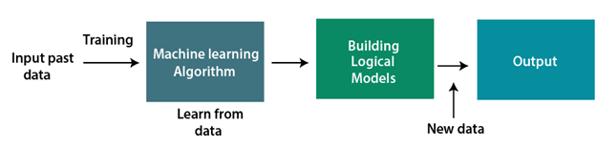
Example
Suppose we have a complex problem, where we need to perform some predictions, so instead of writing a code for it, we just need to feed the data to generic algorithms, and with the help of these algorithms, the machine builds the logic as per the data and predict the output. Machine learning has changed our way of thinking about problems. The below block diagram explains the working of the Machine Learning algorithm:

Slide 7
Features of Machine Learning:
Machine learning uses data to detect various patterns in a given dataset.
It can learn from past data and improve automatically.
It is a data-driven technology.
Machine learning is much similar to data mining as it also deals with the huge amount of the data.

Slide 8
Need for Machine Learning
The need for machine learning is increasing day by day. The reason behind the need for machine learning is that it is capable of doing tasks that are too complex for a person to implement directly. As a human, we have some limitations as we cannot access a huge amount of data manually, so for this, we need some computer systems, and here comes machine learning to make things easy for us.

Slide 9
Key Points
Following are some key points that show the importance of Machine Learning:
Rapid increment in the production of data
Solving complex problems, which are difficult for a human
Decision-making in various sectors including finance
Finding hidden patterns and extracting useful information from data.

Slide 10
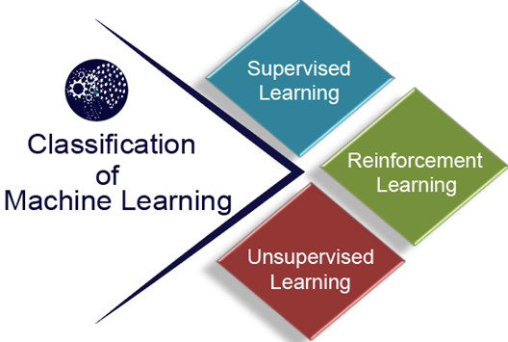
Classification of Machine Learning
At a broad level, machine learning can be classified into three types:
Supervised learning
Unsupervised learning
Reinforcement learning

Slide 11
Supervised Learning
Supervised learning is a type of machine learning method in which we provide sample labeled data to the machine learning system in order to train it, and on that basis, it predicts the output.
The system creates a model using labeled data to understand the datasets and learn about each data, once the training and processing are done then we test the model by providing sample data to check whether it is predicting the exact output or not.

Slide 12
Goal
The goal of supervised learning is to map input data with the output data. Supervised learning is based on supervision, and it is the same as when a student learns things under the supervision of the teacher. An example of supervised learning is spam filtering.
Supervised learning can be grouped further in two categories of algorithms:
Classification
Regression

Slide 13
Unsupervised Learning
Unsupervised learning is a learning method in which a machine learns without any supervision.
The training is provided to the machine with the set of data that has not been labeled, classified, or categorized, and the algorithm needs to act on that data without any supervision. The goal of unsupervised learning is to restructure the input data into new features or a group of objects with similar patterns.

Slide 14
Types of Unsupervised Learning
In unsupervised learning, we don't have a predetermined result. The machine tries to find useful insights from a huge amount of data. It can be further classifieds into two categories of algorithms:
Clustering
Association

Slide 15
Reinforcement Learning
Reinforcement learning is a feedback-based learning method, in which a learning agent gets a reward for each right action and gets a penalty for each wrong action. The agent learns automatically with this feedback and improves its performance. In reinforcement learning, the agent interacts with the environment and explores it. The goal of an agent is to get the most reward points, and hence, it improves its performance.
The robotic dog, which automatically learns the movement of his arms, is an example of Reinforcement learning.

Slide 16
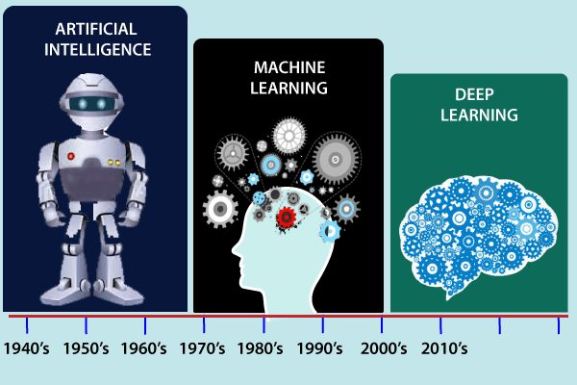
History of Machine Learning
Before some years (about 40-50 years), machine learning was science fiction, but today it is a part of our daily life. Machine learning is making our day-to-day life easy from self-driving cars to Amazon virtual assistant "Alexa". However, the idea behind machine learning is so old and has a long history. Below some milestones are given which have occurred in the history of machine learning:

Slide 17
Machine Learning at present
Now machine learning has got a great advancement in its research, and it is present everywhere around us, such as self-driving cars, Amazon Alexa, Catboats, recommender system, and many more. It includes Supervised, unsupervised, and reinforcement learning with clustering, classification, decision tree, SVM algorithms, etc.
Modern machine learning models can be used for making various predictions, including weather prediction, disease prediction, stock market analysis, etc.

Slide 18
Prerequisites
Before learning machine learning, you must have the basic knowledge of following so that you can easily understand the concepts of machine learning:
Fundamental knowledge of probability and linear algebra.
The ability to code in any computer language, especially in Python language.
Knowledge of Calculus, especially derivatives of a single variable and multivariate functions.

Slide 19
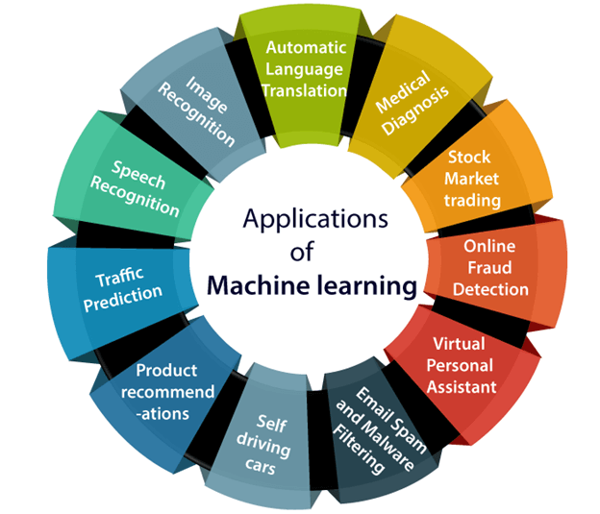
Applications of Machine learning
Machine learning is a buzzword for today's technology, and it is growing very rapidly day by day. We are using machine learning in our daily life even without knowing it such as Google Maps, Google Assistant, Alexa, etc. Below are some most trending real-world applications of Machine Learning:

Slide 20
Machine learning Life cycle
Machine learning has given computer systems the ability to automatically learn without being explicitly programmed. But how does a machine learning system work? So, it can be described using the life cycle of machine learning. The machine learning life cycle is a cyclic process to build an efficient machine learning project. The main purpose of the life cycle is to find a solution to the problem or project.

Slide 21
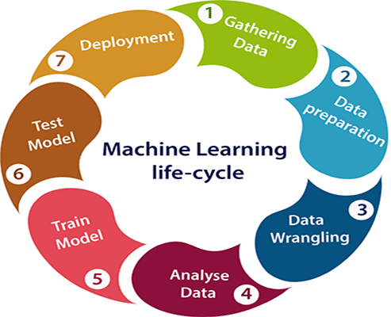
Continue . . .
Machine learning life cycle involves seven major steps, which are given below:
Gathering Data
Data Preparation
Data Wrangling
Analyse Data
Train the model
Test the model
Deployment

Slide 22
Gathering Data
Data Gathering is the first step of the machine learning life cycle. The goal of this step is to identify and obtain all data-related problems.
In this step, we need to identify the different data sources, as data can be collected from various sources such as files, databases, internet, or mobile devices. It is one of the most important steps of the life cycle. The quantity and quality of the collected data will determine the efficiency of the output. The more will be the data, the more accurate will be the prediction.
This step includes the below tasks:
Identify various data sources
Collect data
Integrate the data obtained from different sources

Slide 23
Data preparation
After collecting the data, we need to prepare it for further steps. Data preparation is a step where we put our data into a suitable place and prepare it to use in our machine learning training.
In this step, first, we put all data together, and then randomize the ordering of data.
This step can be further divided into two processes:
Data exploration:
Data pre-processing:

Slide 24
Data exploration
It is used to understand the nature of data that we have to work with. We need to understand the characteristics, format, and quality of data. A better understanding of data leads to an effective outcome. In this, we find Correlations, general trends, and outliers.

Slide 25
Data pre-processing:
Now the next step is preprocessing of data for its analysis.

Slide 26
Data Wrangling
Data wrangling is the process of cleaning and converting raw data into a useable format. It is the process of cleaning the data, selecting the variable to use, and transforming the data in a proper format to make it more suitable for analysis in the next step. It is one of the most important steps of the complete process. Cleaning of data is required to address the quality issues.
It is not necessary that data we have collected is always of our use as some of the data may not be useful. In real-world applications, collected data may have various issues, including:
Missing Values
Duplicate data
Invalid data
Noise
So, we use various filtering techniques to clean the data.

Slide 27
Data Analysis
Now the cleaned and prepared data is passed on to the analysis step. This step involves:
Selection of analytical techniques
Building models
Review the result

Slide 28
Train Model
Now the next step is to train the model, in this step we train our model to improve its performance for better outcome of the problem.
We use datasets to train the model using various machine learning algorithms. Training a model is required so that it can understand the various patterns, rules, and, features.

Slide 29
Test Model
Once our machine learning model has been trained on a given dataset, then we test the model. In this step, we check for the accuracy of our model by providing a test dataset to it.
Testing the model determines the percentage accuracy of the model as per the requirement of project or problem.

Slide 30
Deployment
The last step of machine learning life cycle is deployment, where we deploy the model in the real-world system.

Slide 31
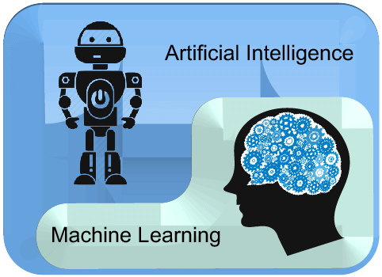
Difference between Artificial intelligence and Machine learning
AI is a bigger concept to create intelligent machines that can simulate human thinking capability and behavior, whereas, machine learning is an application or subset of AI that allows machines to learn from data without being programmed explicitly.

Slide 32
Artificial Intelligence | Machine learning
Artificial intelligence is a technology which enables a machine to simulate human behavior. | Machine learning is a subset of AI which allows a machine to automatically learn from past data without programming explicitly.
The goal of AI is to make a smart computer system like humans to solve complex problems. | The goal of ML is to allow machines to learn from data so that they can give accurate output.
In AI, we make intelligent systems to perform any task like a human. | In ML, we teach machines with data to perform a particular task and give an accurate result.
Machine learning and deep learning are the two main subsets of AI. | Deep learning is a main subset of machine learning.
AI has a very wide range of scope. | Machine learning has a limited scope.
AI is working to create an intelligent system which can perform various complex tasks. | Machine learning is working to create machines that can perform only those specific tasks for which they are trained.
AI system is concerned about maximizing the chances of success. | Machine learning is mainly concerned about accuracy and patterns.
The main applications of AI are Siri, customer support using catboats, Expert System, Online game playing, intelligent humanoid robot, etc. | The main applications of machine learning are Online recommender system, Google search algorithms, Facebook auto friend tagging suggestions, etc.
On the basis of capabilities, AI can be divided into three types, which are, Weak AI, General AI, and Strong AI. | Machine learning can also be divided into mainly three types that are Supervised learning, Unsupervised learning, and Reinforcement learning.
It includes learning, reasoning, and self-correction. | It includes learning and self-correction when introduced with new data.
AI completely deals with Structured, semi-structured, and unstructured data. | Machine learning deals with Structured and semi-structured data.

Slide 33
Machine Learning - Linear Regression
Regression
The term regression is used when you try to find the relationship between variables.
In Machine Learning, and in statistical modeling, that relationship is used to predict the outcome of future events.

Slide 34
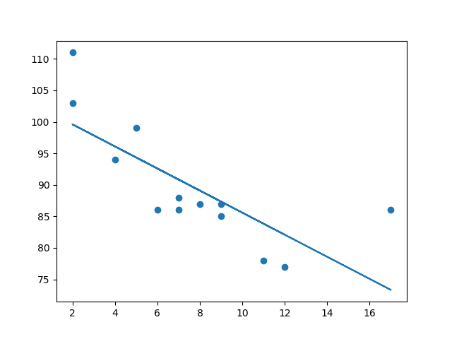
Linear Regression
Linear regression uses the relationship between the data-points to draw a straight line through all them.
This line can be used to predict future values.

Slide 35
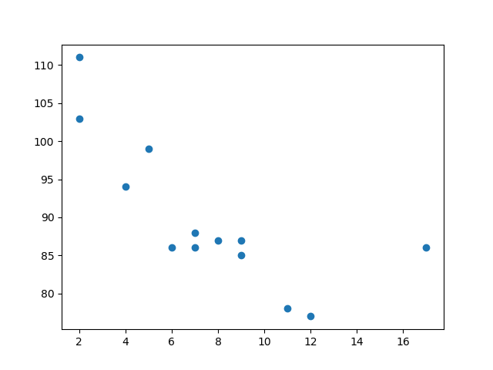
Example
Start by drawing a scatter plot:
import matplotlib.pyplot as plt x = [5,7,8,7,2,17,2,9,4,11,12,9,6] y = [99,86,87,88,111,86,103,87,94,78,77,85,86] plt.scatter(x, y) plt.show()

Slide 36
Example
Import scipy and draw the line of Linear Regression:
import matplotlib.pyplot as plt from scipy import stats x = [5,7,8,7,2,17,2,9,4,11,12,9,6] y = [99,86,87,88,111,86,103,87,94,78,77,85,86] slope, intercept, r, p, std_err = stats.linregress(x, y) def myfunc(x): return slope * x + intercept mymodel = list(map(myfunc, x)) plt.scatter(x, y) plt.plot(x, mymodel) plt.show()

Slide 37
Example Explained
Import the modules you need.
import matplotlib.pyplot as plt from scipy import stats
Create the arrays that represent the values of the x and y axis:
x = [5,7,8,7,2,17,2,9,4,11,12,9,6] y = [99,86,87,88,111,86,103,87,94,78,77,85,86]
Execute a method that returns some important key values of Linear Regression:
slope, intercept, r, p, std_err = stats.linregress(x, y)
Create a function that uses the slope and intercept values to return a new value. This new value represents where on the y-axis the corresponding x value will be placed:
def myfunc(x): return slope * x + intercept
Run each value of the x array through the function. This will result in a new array with new values for the y-axis:
mymodel = list(map(myfunc, x))
Draw the original scatter plot:
plt.scatter(x, y)
Draw the line of linear regression:
plt.plot(x, mymodel)
Display the diagram:
plt.show()

Slide 38
R for Relationship
It is important to know how the relationship between the values of the x-axis and the values of the y-axis is, if there are no relationship the linear regression can not be used to predict anything.
This relationship - the coefficient of correlation - is called r.
The r value ranges from -1 to 1, where 0 means no relationship, and 1 (and -1) means 100% related.
Python and the Scipy module will compute this value for you, all you have to do is feed it with the x and y values.

Slide 39
Example
How well does my data fit in a linear regression?
from scipy import stats x = [5,7,8,7,2,17,2,9,4,11,12,9,6] y = [99,86,87,88,111,86,103,87,94,78,77,85,86] slope, intercept, r, p, std_err = stats.linregress(x, y) print(r)

Slide 40
Predict Future Values
Now we can use the information we have gathered to predict future values.
Example: Let us try to predict the speed of a 10 years old car.
To do so, we need the same myfunc() function from the example above:
def myfunc(x): return slope * x + intercept

Slide 41
Example
Predict the speed of a 10 years old car:
from scipy import stats x = [5,7,8,7,2,17,2,9,4,11,12,9,6] y = [99,86,87,88,111,86,103,87,94,78,77,85,86] slope, intercept, r, p, std_err = stats.linregress(x, y) def myfunc(x): return slope * x + intercept speed = myfunc(10) print(speed)

Slide 42
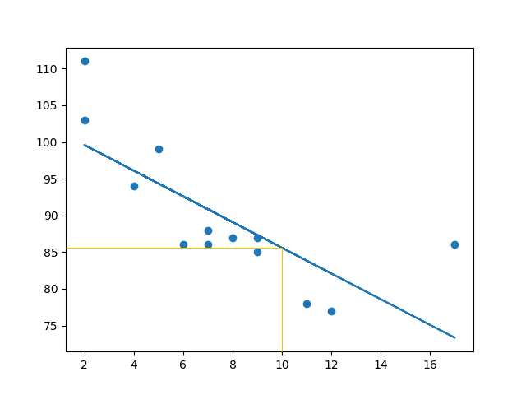
The example predicted a speed at 85.6, which we also could read from the diagram:

Slide 43
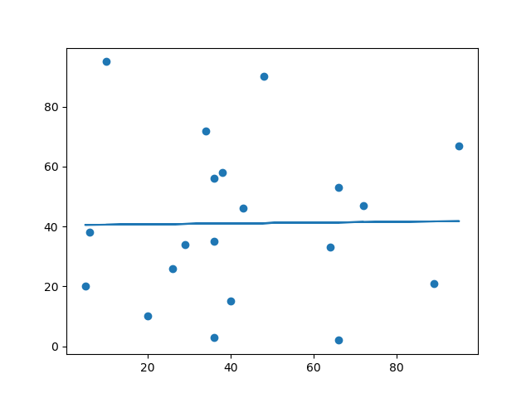
Bad Fit?
Let us create an example where linear regression would not be the best method to predict future values.
import matplotlib.pyplot as plt from scipy import stats x = [89,43,36,36,95,10,66,34,38,20,26,29,48,64,6,5,36,66,72,40] y = [21,46,3,35,67,95,53,72,58,10,26,34,90,33,38,20,56,2,47,15] slope, intercept, r, p, std_err = stats.linregress(x, y) def myfunc(x): return slope * x + intercept mymodel = list(map(myfunc, x)) plt.scatter(x, y) plt.plot(x, mymodel) plt.show()

Slide 44
Machine Learning - Polynomial Regression
If your data points clearly will not fit a linear regression (a straight line through all data points), it might be ideal for polynomial regression.
Polynomial regression, like linear regression, uses the relationship between the variables x and y to find the best way to draw a line through the data points.

Slide 45
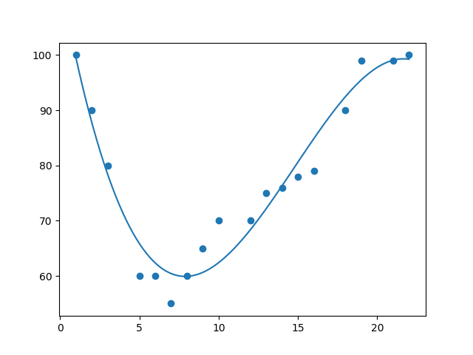

Slide 46
How Does it Work?
Python has methods for finding a relationship between data-points and to draw a line of polynomial regression. We will show you how to use these methods instead of going through the mathematic formula.
In the example below, we have registered 18 cars as they were passing a certain tollbooth.
We have registered the car's speed, and the time of day (hour) the passing occurred.
The x-axis represents the hours of the day and the y-axis represents the speed:

Slide 47
Example
Start by drawing a scatter plot:
import matplotlib.pyplot as plt x = [1,2,3,5,6,7,8,9,10,12,13,14,15,16,18,19,21,22] y = [100,90,80,60,60,55,60,65,70,70,75,76,78,79,90,99,99,100] plt.scatter(x, y) plt.show()

Slide 48
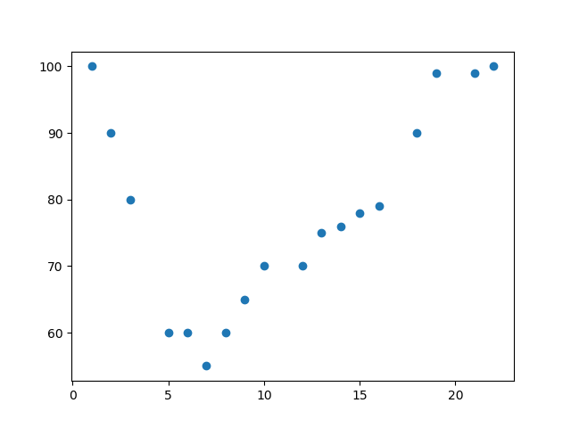

Slide 49
Example
Import numpy and matplotlib then draw the line of Polynomial Regression:
import numpy import matplotlib.pyplot as plt x = [1,2,3,5,6,7,8,9,10,12,13,14,15,16,18,19,21,22] y = [100,90,80,60,60,55,60,65,70,70,75,76,78,79,90,99,99,100] mymodel = numpy.poly1d(numpy.polyfit(x, y, 3)) myline = numpy.linspace(1, 22, 100) plt.scatter(x, y) plt.plot(myline, mymodel(myline)) plt.show()

Slide 50
Example Explained
Import the modules you need.
import numpy import matplotlib.pyplot as plt
Create the arrays that represent the values of the x and y axis:
x = [1,2,3,5,6,7,8,9,10,12,13,14,15,16,18,19,21,22] y = [100,90,80,60,60,55,60,65,70,70,75,76,78,79,90,99,99,100]
NumPy has a method that lets us make a polynomial model:
mymodel = numpy.poly1d(numpy.polyfit(x, y, 3))
Then specify how the line will display, we start at position 1, and end at position 22:
myline = numpy.linspace(1, 22, 100)
Draw the original scatter plot:
plt.scatter(x, y)
Draw the line of polynomial regression:
plt.plot(myline, mymodel(myline))
Display the diagram:
plt.show()

Slide 51
R-Squared
It is important to know how well the relationship between the values of the x- and y-axis is, if there are no relationship the polynomial regression can not be used to predict anything.
The relationship is measured with a value called the r-squared.
The r-squared value ranges from 0 to 1, where 0 means no relationship, and 1 means 100% related.
Python and the Sklearn module will compute this value for you, all you have to do is feed it with the x and y arrays:

Slide 52
Example
How well does my data fit in a polynomial regression?
import numpy from sklearn.metrics import r2_score x = [1,2,3,5,6,7,8,9,10,12,13,14,15,16,18,19,21,22] y = [100,90,80,60,60,55,60,65,70,70,75,76,78,79,90,99,99,100] mymodel = numpy.poly1d(numpy.polyfit(x, y, 3)) print(r2_score(y, mymodel(x)))

Slide 53
Predict Future Values
Now we can use the information we have gathered to predict future values.
Example: Let us try to predict the speed of a car that passes the tollbooth at around the time 17:00:
To do so, we need the same mymodel array from the example above:
mymodel = numpy.poly1d(numpy.polyfit(x, y, 3))
Example
Predict the speed of a car passing at 17:00:
import numpy from sklearn.metrics import r2_score x = [1,2,3,5,6,7,8,9,10,12,13,14,15,16,18,19,21,22] y = [100,90,80,60,60,55,60,65,70,70,75,76,78,79,90,99,99,100] mymodel = numpy.poly1d(numpy.polyfit(x, y, 3)) speed = mymodel(17) print(speed)

Slide 54
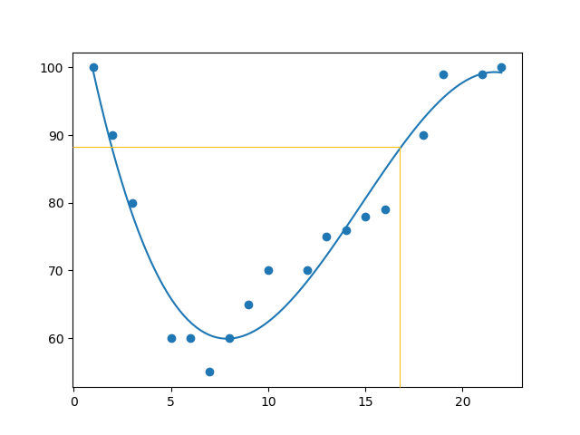

Slide 55
Bad Fit?
Example
These values for the x- and y-axis should result in a very bad fit for polynomial regression:
import numpy import matplotlib.pyplot as plt x = [89,43,36,36,95,10,66,34,38,20,26,29,48,64,6,5,36,66,72,40] y = [21,46,3,35,67,95,53,72,58,10,26,34,90,33,38,20,56,2,47,15] mymodel = numpy.poly1d(numpy.polyfit(x, y, 3)) myline = numpy.linspace(2, 95, 100) plt.scatter(x, y) plt.plot(myline, mymodel(myline)) plt.show()

Slide 56
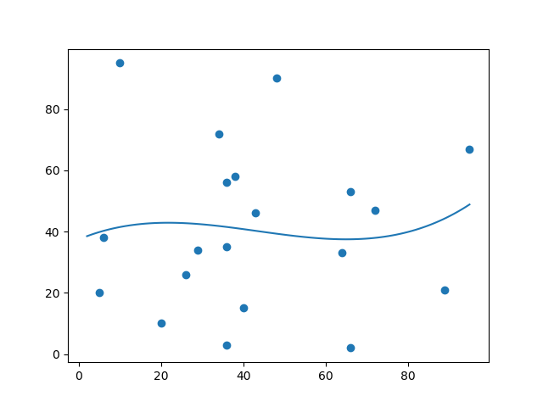

Slide 57
Machine Learning - K-nearest neighbors (KNN)
KNN is a simple, supervised machine learning (ML) algorithm that can be used for classification or regression tasks - and is also frequently used in missing value imputation. It is based on the idea that the observations closest to a given data point are the most "similar" observations in a data set, and we can therefore classify unforeseen points based on the values of the closest existing points. By choosing K, the user can select the number of nearby observations to use in the algorithm.

Slide 58
How does it work?
K is the number of nearest neighbors to use. For classification, a majority vote is used to determined which class a new observation should fall into. Larger values of K are often more robust to outliers and produce more stable decision boundaries than very small values (K=3 would be better than K=1, which might produce undesirable results.

Slide 59
Example
Start by visualizing some data points:
import matplotlib.pyplot as plt x = [4, 5, 10, 4, 3, 11, 14 , 8, 10, 12] y = [21, 19, 24, 17, 16, 25, 24, 22, 21, 21] classes = [0, 0, 1, 0, 0, 1, 1, 0, 1, 1] plt.scatter(x, y, c=classes) plt.show()

Slide 60
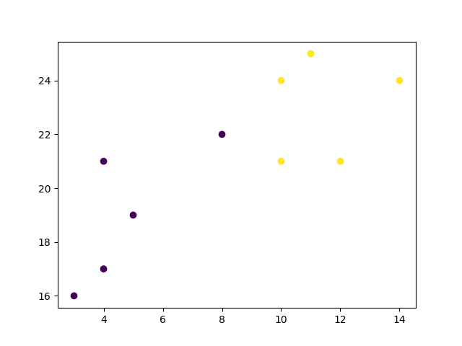

Slide 61
Now we fit the KNN algorithm with K=1:
from sklearn.neighbors import KNeighborsClassifier data = list(zip(x, y)) knn = KNeighborsClassifier(n_neighbors=1) knn.fit(data, classes)
And use it to classify a new data point:

Slide 62
Example
new_x = 8 new_y = 21 new_point = [(new_x, new_y)] prediction = knn.predict(new_point) plt.scatter(x + [new_x], y + [new_y], c=classes + [prediction[0]]) plt.text(x=new_x-1.7, y=new_y-0.7, s=f"new point, class: {prediction[0]}") plt.show()

Slide 63
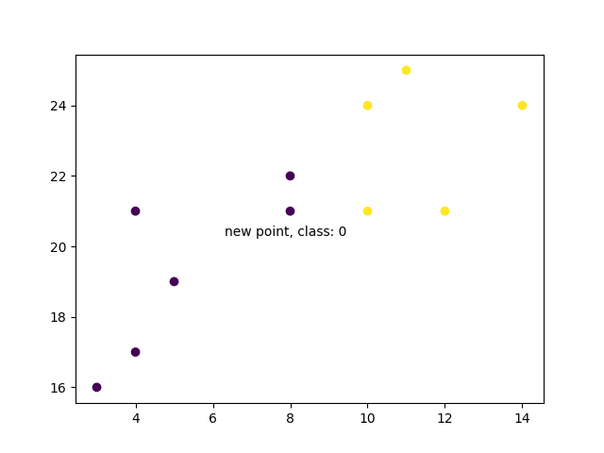

Slide 64
Now we do the same thing, but with a higher K value which changes the prediction:
knn = KNeighborsClassifier(n_neighbors=5) knn.fit(data, classes) prediction = knn.predict(new_point) plt.scatter(x + [new_x], y + [new_y], c=classes + [prediction[0]]) plt.text(x=new_x-1.7, y=new_y-0.7, s=f"new point, class: {prediction[0]}") plt.show()

Slide 65
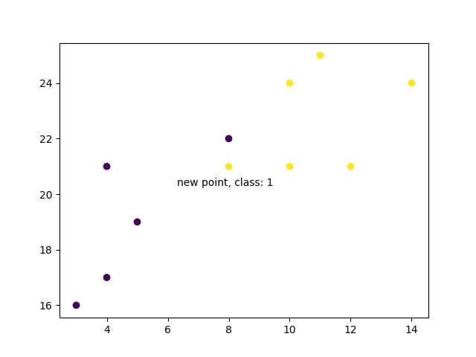

Slide 66
Example Explained
Import the modules you need.
import matplotlib.pyplot as plt from sklearn.neighbors import KNeighborsClassifier
Create arrays that resemble variables in a dataset. We have two input features (x and y) and then a target class (class). The input features that are pre-labeled with our target class will be used to predict the class of new data. Note that while we only use two input features here, this method will work with any number of variables:
x = [4, 5, 10, 4, 3, 11, 14 , 8, 10, 12] y = [21, 19, 24, 17, 16, 25, 24, 22, 21, 21] classes = [0, 0, 1, 0, 0, 1, 1, 0, 1, 1]

Slide 67
Turn the input features into a set of points:
data = list(zip(x, y))
print(data)
Result:
[(4, 21), (5, 19), (10, 24), (4, 17), (3, 16), (11, 25), (14, 24), (8, 22), (10, 21), (12, 21)]

Slide 68
Using the input features and target class, we fit a KNN model on the model using 1 nearest neighbor:
knn = KNeighborsClassifier(n_neighbors=1)
knn.fit(data, classes)
Then, we can use the same KNN object to predict the class of new, unforeseen data points. First we create new x and y features, and then call knn.predict() on the new data point to get a class of 0 or 1:
new_x = 8
new_y = 21
new_point = [(new_x, new_y)]
prediction = knn.predict(new_point)
print(prediction)

Slide 69
Result:
[0]

Slide 70
When we plot all the data along with the new point and class, we can see it's been labeled blue with the 1 class. The text annotation is just to highlight the location of the new point:
plt.scatter(x + [new_x], y + [new_y], c=classes + [prediction[0]])
plt.text(x=new_x-1.7, y=new_y-0.7, s=f"new point, class: {prediction[0]}")
plt.show()

Slide 72
However, when we changes the number of neighbors to 5, the number of points used to classify our new point changes. As a result, so does the classification of the new point:
knn = KNeighborsClassifier(n_neighbors=5) knn.fit(data, classes) prediction = knn.predict(new_point) print(prediction)
Result:
[1]

Slide 73
When we plot the class of the new point along with the older points, we note that the color has changed based on the associated class label:
plt.scatter(x + [new_x], y + [new_y], c=classes + [prediction[0]]) plt.text(x=new_x-1.7, y=new_y-0.7, s=f"new point, class: {prediction[0]}") plt.show()

Slide 75
K-nearest neighbors (KNN)
KNN is a simple, supervised machine learning (ML) algorithm that can be used for classification or regression tasks. It is based on the idea that the observations closest to a given data point are the most "similar" observations in a data set, and we can therefore classify unforeseen points based on the values of the closest existing points. By choosing K, the user can select the number of nearby observations to use in the algorithm.

Slide 76
How does it work?
K is the number of nearest neighbors to use. For classification, a majority vote is used to determine which class a new observation should fall into. Larger values of K are often more robust to outliers and produce more stable decision boundaries than very small values (K=3 would be better than K=1, which might produce undesirable results.

Slide 77
Example
Start by visualizing some data points:
import matplotlib.pyplot as plt x = [4, 5, 10, 4, 3, 11, 14 , 8, 10, 12] y = [21, 19, 24, 17, 16, 25, 24, 22, 21, 21] classes = [0, 0, 1, 0, 0, 1, 1, 0, 1, 1] plt.scatter(x, y, c=classes) plt.show()

Slide 78
Now we fit the KNN algorithm with K=1:
from sklearn.neighbors import KNeighborsClassifier data = list(zip(x, y)) knn = KNeighborsClassifier(n_neighbors=1) knn.fit(data, classes)
Example
new_x = 8 new_y = 21 new_point = [(new_x, new_y)] prediction = knn.predict(new_point) plt.scatter(x + [new_x], y + [new_y], c=classes + [prediction[0]]) plt.text(x=new_x-1.7, y=new_y-0.7, s=f"new point, class: {prediction[0]}") plt.show()

Slide 79
Now we do the same thing, but with a higher K value which changes the prediction
Example
knn = KNeighborsClassifier(n_neighbors=5) knn.fit(data, classes) prediction = knn.predict(new_point) plt.scatter(x + [new_x], y + [new_y], c=classes + [prediction[0]]) plt.text(x=new_x-1.7, y=new_y-0.7, s=f"new point, class: {prediction[0]}") plt.show()
e prediction:

Slide 80
Example Explained
Import the modules you need.
import matplotlib.pyplot as plt from sklearn.neighbors import KNeighborsClassifier
Create arrays that resemble variables in a dataset. We have two input features (x and y) and then a target class (class). The input features that are pre-labeled with our target class will be used to predict the class of new data. Note that while we only use two input features here, this method will work with any number of variables:
x = [4, 5, 10, 4, 3, 11, 14 , 8, 10, 12] y = [21, 19, 24, 17, 16, 25, 24, 22, 21, 21] classes = [0, 0, 1, 0, 0, 1, 1, 0, 1, 1]
Turn the input features into a set of points:
data = list(zip(x, y)) print(data)
Result:
[(4, 21), (5, 19), (10, 24), (4, 17), (3, 16), (11, 25), (14, 24), (8, 22), (10, 21), (12, 21)]
Using the input features and target class, we fit a KNN model on the model using 1 nearest neighbor:
knn = KNeighborsClassifier(n_neighbors=1) knn.fit(data, classes)
Then, we can use the same KNN object to predict the class of new, unforeseen data points. First we create new x and y features, and then call knn.predict() on the new data point to get a class of 0 or 1:
new_x = 8 new_y = 21 new_point = [(new_x, new_y)] prediction = knn.predict(new_point) print(prediction)
Result:
[0]

Slide 81
When we plot all the data along with the new point and class, we can see it's been labeled blue with the 1 class. The text annotation is just to highlight the location of the new point:
plt.scatter(x + [new_x], y + [new_y], c=classes + [prediction[0]]) plt.text(x=new_x-1.7, y=new_y-0.7, s=f"new point, class: {prediction[0]}") plt.show()

Slide 82
However, when we changes the number of neighbors to 5, the number of points used to classify our new point changes. As a result, so does the classification of the new point:
knn = KNeighborsClassifier(n_neighbors=5) knn.fit(data, classes) prediction = knn.predict(new_point) print(prediction)
Result:
[1]
When we plot the class of the new point along with the older points, we note that the color has changed based on the associated class label:
plt.scatter(x + [new_x], y + [new_y], c=classes + [prediction[0]]) plt.text(x=new_x-1.7, y=new_y-0.7, s=f"new point, class: {prediction[0]}") plt.show()

Slide 83
Decision Tree
Decision Tree is a Supervised learning technique that can be used for both classification and Regression problems, but mostly it is preferred for solving Classification problems. It is a tree-structured classifier, where internal nodes represent the features of a dataset, branches represent the decision rules and each leaf node represents the outcome.
In a Decision tree, there are two nodes, which are the Decision Node and Leaf Node. Decision nodes are used to make any decision and have multiple branches, whereas Leaf nodes are the output of those decisions and do not contain any further branches.
The decisions or the test are performed on the basis of features of the given dataset.
It is a graphical representation for getting all the possible solutions to a problem/decision based on given conditions.
It is called a decision tree because, similar to a tree, it starts with the root node, which expands on further branches and constructs a tree-like structure.
In order to build a tree, we use the CART algorithm, which stands for Classification and Regression Tree algorithm.
A decision tree simply asks a question, and based on the answer (Yes/No), it further split the tree into subtrees.

Slide 84


Slide 85
Why use Decision Trees?
There are various algorithms in Machine learning, so choosing the best algorithm for the given dataset and problem is the main point to remember while creating a machine learning model. Below are the two reasons for using the Decision tree:
Decision Trees usually mimic human thinking ability while making a decision, so it is easy to understand.
The logic behind the decision tree can be easily understood because it shows a tree-like structure.

Slide 86
Decision Tree Terminologies
Root Node: Root node is from where the decision tree starts. It represents the entire dataset, which further gets divided into two or more homogeneous sets.
Leaf Node: Leaf nodes are the final output node, and the tree cannot be segregated further after getting a leaf node.
Splitting: Splitting is the process of dividing the decision node/root node into sub-nodes according to the given conditions.
Branch/Sub Tree: A tree formed by splitting the tree.
Pruning: Pruning is the process of removing the unwanted branches from the tree.
Parent/Child node: The root node of the tree is called the parent node, and other nodes are called the child nodes.

Slide 87
How Does it Work?
First, read the dataset with pandas:
Example
Read and print the data set:
import pandas df = pandas.read_csv("data.csv") print(df)

Slide 88
To make a decision tree, all data has to be numerical.
We have to convert the non numerical columns 'Nationality' and 'Go' into numerical values.
Pandas has a map() method that takes a dictionary with information on how to convert the values.
{'UK': 0, 'USA': 1, 'N': 2}
Means convert the values 'UK' to 0, 'USA' to 1, and 'N' to 2.
Example
Change string values into numerical values:
d = {'UK': 0, 'USA': 1, 'N': 2} df['Nationality'] = df['Nationality'].map(d) d = {'YES': 1, 'NO': 0} df['Go'] = df['Go'].map(d) print(df)

Slide 89
Then we have to separate the feature columns from the target column.
The feature columns are the columns that we try to predict from, and the target column is the column with the values we try to predict.
Example
X is the feature columns, y is the target column:
features = ['Age', 'Experience', 'Rank', 'Nationality'] X = df[features] y = df['Go'] print(X) print(y)

Slide 90
Now we can create the actual decision tree, fit it with our details. Start by importing the modules we need:
Example
Create and display a Decision Tree:
import pandas from sklearn import tree from sklearn.tree import DecisionTreeClassifier import matplotlib.pyplot as plt df = pandas.read_csv("data.csv") d = {'UK': 0, 'USA': 1, 'N': 2} df['Nationality'] = df['Nationality'].map(d) d = {'YES': 1, 'NO': 0} df['Go'] = df['Go'].map(d) features = ['Age', 'Experience', 'Rank', 'Nationality'] X = df[features] y = df['Go'] dtree = DecisionTreeClassifier() dtree = dtree.fit(X, y) tree.plot_tree(dtree, feature_names=features)

Slide 91
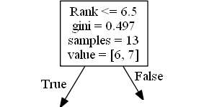
Result Explained
The decision tree uses your earlier decisions to calculate the odds for you to wanting to go see a comedian or not.
Let us read the different aspects of the decision tree:

Slide 92
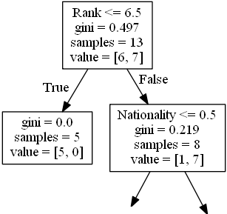
Rank
Rank <= 6.5 means that every comedian with a rank of 6.5 or lower will follow the True arrow (to the left), and the rest will follow the False arrow (to the right).
gini = 0.497 refers to the quality of the split, and is always a number between 0.0 and 0.5, where 0.0 would mean all of the samples got the same result, and 0.5 would mean that the split is done exactly in the middle.
samples = 13 means that there are 13 comedians left at this point in the decision, which is all of them since this is the first step.
value = [6, 7] means that of these 13 comedians, 6 will get a "NO", and 7 will get a "GO".
Gini
There are many ways to split the samples, we use the GINI method in this tutorial.
The Gini method uses this formula:
Gini = 1 - (x/n)² - (y/n)²
Where x is the number of positive answers("GO"), n is the number of samples, and y is the number of negative answers ("NO"), which gives us this calculation:
1 - (7 / 13)² - (6 / 13)² = 0.497

Slide 93
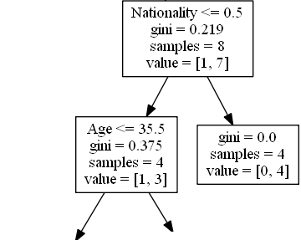
The next step contains two boxes, one box for the comedians with a 'Rank' of 6.5 or lower, and one box with the rest.
True - 5 Comedians End Here:
gini = 0.0 means all of the samples got the same result.
samples = 5 means that there are 5 comedians left in this branch (5 comedian with a Rank of 6.5 or lower).
value = [5, 0] means that 5 will get a "NO" and 0 will get a "GO".
False - 8 Comedians Continue:
Nationality
Nationality <= 0.5 means that the comedians with a nationality value of less than 0.5 will follow the arrow to the left (which means everyone from the UK, ), and the rest will follow the arrow to the right.
gini = 0.219 means that about 22% of the samples would go in one direction.
samples = 8 means that there are 8 comedians left in this branch (8 comedian with a Rank higher than 6.5).
value = [1, 7] means that of these 8 comedians, 1 will get a "NO" and 7 will get a "GO".

Slide 94
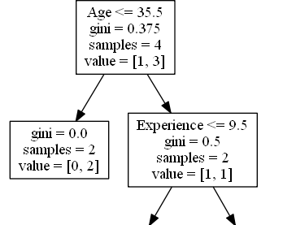
True - 4 Comedians Continue:
Age
Age <= 35.5 means that comedians at the age of 35.5 or younger will follow the arrow to the left, and the rest will follow the arrow to the right.
gini = 0.375 means that about 37,5% of the samples would go in one direction.
samples = 4 means that there are 4 comedians left in this branch (4 comedians from the UK).
value = [1, 3] means that of these 4 comedians, 1 will get a "NO" and 3 will get a "GO".
False - 4 Comedians End Here:
gini = 0.0 means all of the samples got the same result.
samples = 4 means that there are 4 comedians left in this branch (4 comedians not from the UK).
value = [0, 4] means that of these 4 comedians, 0 will get a "NO" and 4 will get a "GO".

Slide 95
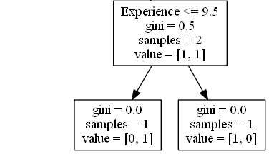
True - 2 Comedians End Here:
gini = 0.0 means all of the samples got the same result.
samples = 2 means that there are 2 comedians left in this branch (2 comedians at the age 35.5 or younger).
value = [0, 2] means that of these 2 comedians, 0 will get a "NO" and 2 will get a "GO".
False - 2 Comedians Continue:
Experience
Experience <= 9.5 means that comedians with 9.5 years of experience, or less, will follow the arrow to the left, and the rest will follow the arrow to the right.
gini = 0.5 means that 50% of the samples would go in one direction.
samples = 2 means that there are 2 comedians left in this branch (2 comedians older than 35.5).
value = [1, 1] means that of these 2 comedians, 1 will get a "NO" and 1 will get a "GO".

Slide 96
True - 1 Comedian Ends Here:
gini = 0.0 means all of the samples got the same result.
samples = 1 means that there is 1 comedian left in this branch (1 comedian with 9.5 years of experience or less).
value = [0, 1] means that 0 will get a "NO" and 1 will get a "GO".
False - 1 Comedian Ends Here:
gini = 0.0 means all of the samples got the same result.
samples = 1 means that there is 1 comedians left in this branch (1 comedian with more than 9.5 years of experience).
value = [1, 0] means that 1 will get a "NO" and 0 will get a "GO".

Slide 97
Predict Values
We can use the Decision Tree to predict new values.
Example: Should I go see a show starring a 40 years old American comedian, with 10 years of experience, and a comedy ranking of 7?
Example
Use predict() method to predict new values:
print(dtree.predict([[40, 10, 7, 1]]))

Slide 98
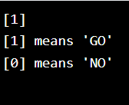
Example
import pandas
from sklearn import tree
from sklearn.tree import DecisionTreeClassifier
df = pandas.read_csv("data.csv")
d = {'UK': 0, 'USA': 1, 'N': 2}
df['Nationality'] = df['Nationality'].map(d)
d = {'YES': 1, 'NO': 0}
df['Go'] = df['Go'].map(d)
features = ['Age', 'Experience', 'Rank', 'Nationality']
X = df[features]
y = df['Go']
dtree = DecisionTreeClassifier()
dtree = dtree.fit(X, y)
print(dtree.predict([[40, 10, 7, 1]]))
print("[1] means 'GO'")
print("[0] means 'NO'")

Slide 99
Example
What would the answer be if the comedy rank was 6?
print(dtree.predict([[40, 10, 6, 1]]))

Slide 100
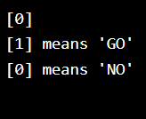
import pandas
from sklearn import tree
from sklearn.tree import DecisionTreeClassifier
df = pandas.read_csv("data.csv")
d = {'UK': 0, 'USA': 1, 'N': 2}
df['Nationality'] = df['Nationality'].map(d)
d = {'YES': 1, 'NO': 0}
df['Go'] = df['Go'].map(d)
features = ['Age', 'Experience', 'Rank', 'Nationality']
X = df[features]
y = df['Go']
dtree = DecisionTreeClassifier()
dtree = dtree.fit(X, y)
print(dtree.predict([[40, 10, 6, 1]]))
print("[1] means 'GO'")
print("[0] means 'NO'")

